Slide 1

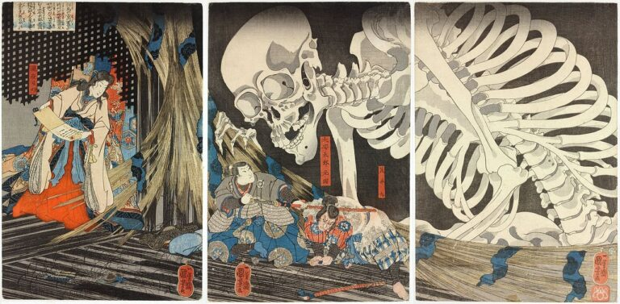
Night of the living Yōkai

Slide 2
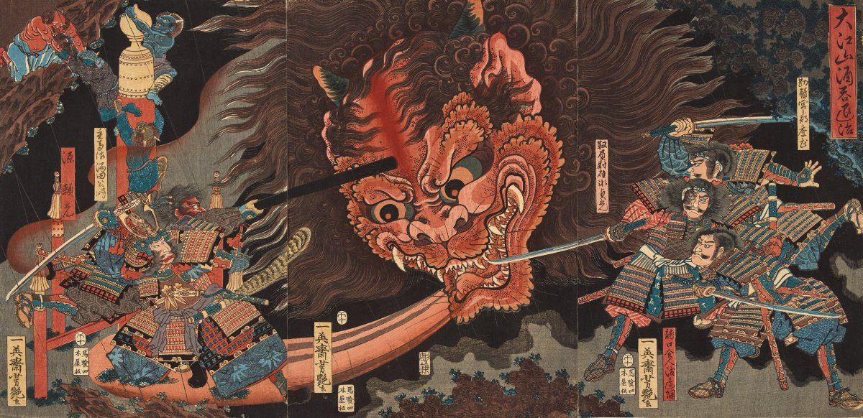
Core Ideas
Core Concept
Core Gameplay Loop
Wave-Based First-Person Combat.
Player starts at a house.
When meeting the local god, the waves of yokai spawns in the shrine yard and need to be defeated.
Interaction with good yokai for buffs.
Progression through unlockable weapons and abilities.
The player spawns into the game
The player needs to equipped a katana from a small shrine.
After meeting the local god at the shrine, the first wave starts.
Each wave ends when all yokai are defeated.
As waves progress, the player will have a random chance of interaction with a good yokai for buffs.
As the wave progress, the player will earn points based on how many kills they have and will have time to use them for unlocking abilities or other weapons.
The game ends when the player dies.

Slide 3
Done Task Check list
Environment & World Systems
User Interface
Shrine Yard landscape design.
Rain/Weather system.
AI spawn system.
Round base system.
Score keeping system.
NPC interaction system.
Display player’s health.
Display wave counter.
Display Enemies Left/Enemies saved.
Display points
Display abilities’ information.
Display current weapon in hand.
Display secondary weapon.
Display main menu and pause menu.
Combat
Enemy AI (attacking, walking, targeting) behavior tree.
Player weapon swapping and attacking system: Gohei, and Kusanagi no Tsurugi (sword).
Buff system (health regen, speed, damage, and defence).
Ability system
Damage & Health system.
Audio
Basic player’s audio.
Basic enemies’ audio.
Environment audio.
Basic combat audio.

Slide 4

What I needed to research
Ai spawning and wave scaling logic.
Weapon swapping logic.
Detailed custom animations.
Audio for player and ai movements.
Dialogue system.
What I needed outside Help On
Ability system.
Audio triggers when an animation notification triggers.

Slide 5
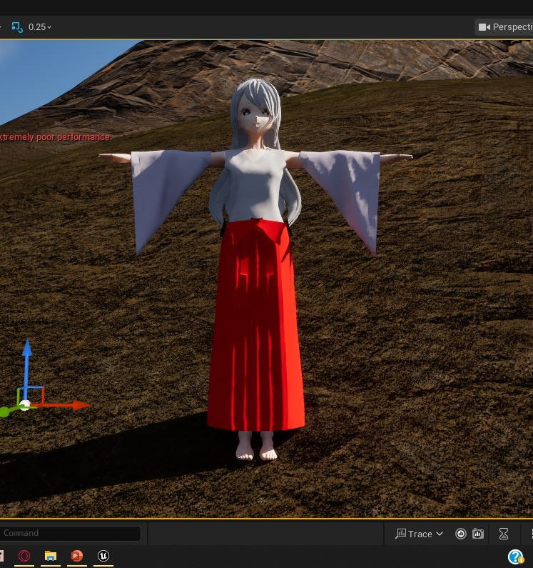
required Assets
Type | Name
Player | First Person Shrine Maiden model.
World | Shrine, trees, plants, landscape, rocks, rain, Oda Era houses and buildings, shrine decorations, environmental decals, river, underbrush, bushes.
Enemies | 4 different types of yokai.
Allies | 2 different types of yokai. (Plus, images for interactions)
weapon | 2 different types of weapons. (katana, Gohei)
Sounds | Running, attacking, enemies sounds, raining sounds.
UI | Level-Up images, Ability Shrine images, Pause/Main Menu/Game Over/Options/Loading UI icons, and Lastly wounded player image.
Main Character

Slide 6
Task Not Finished Check list
Environment & World Systems
User Interface
Interactive Day/Night cycle.
Need to do more performance boosting
Include a working Options system for main menu.
Combat
Audio
Player Jump.
Include Boss Enemy AI.
Player Bow attacking system

